Slide 1

SYSTEM-DRIVEN HARDWARE DESIGN
Rakshitha Kukke Prakash 1127988
Henrique Rangan 1130830
Group C5
24GHz-Radar for Movement Detection

Slide 2

AGENDA
01
PCB Schematic
04
FFT on PSoC
02
Statemachine
05
CFAR
03
FFT on Matlab
06
Exercises

Slide 3
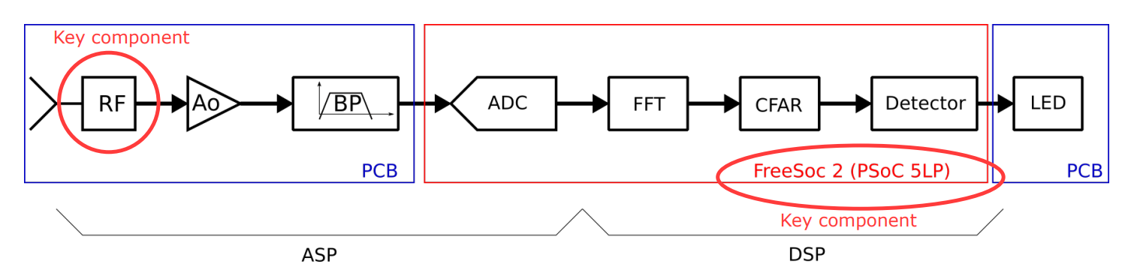
SYS-Architecture: Signal Flow Diagram to implement the objective
System function: A 24 GHz radar detects movements and signals this by turning on a red LED, as long as a movement is detected.

Slide 4
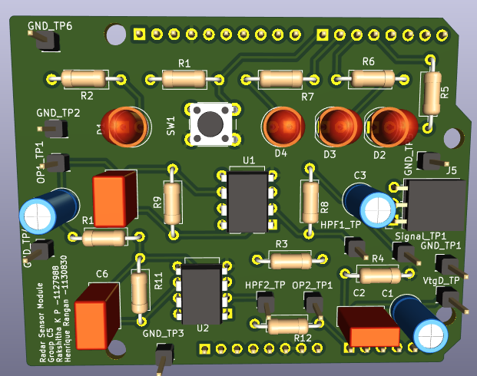
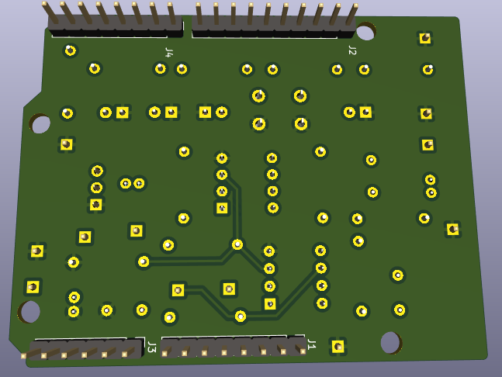
PCB CIRCUIT
Description: PCB front side implemented in KiCAD
Description: PCB back side implemented in KiCAD

Slide 5
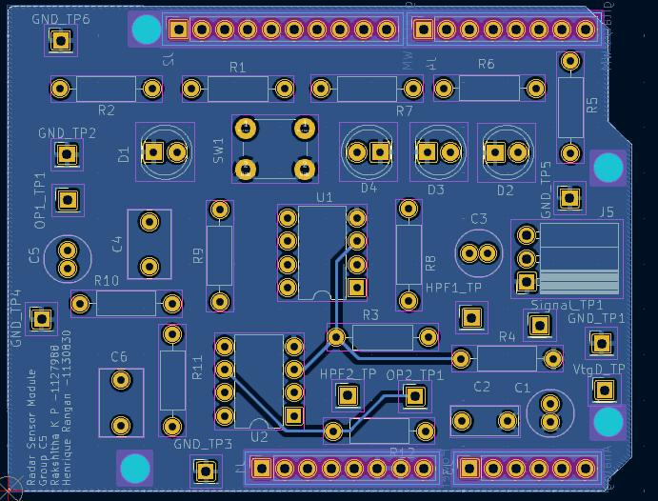
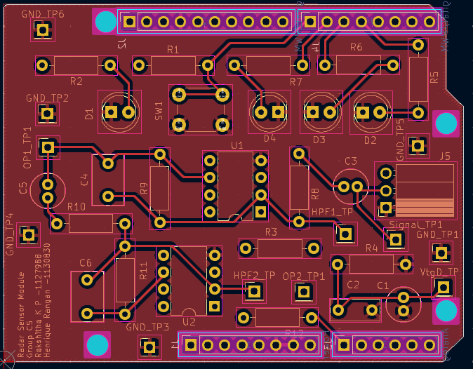
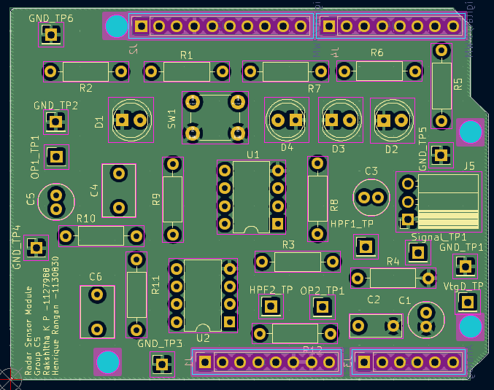
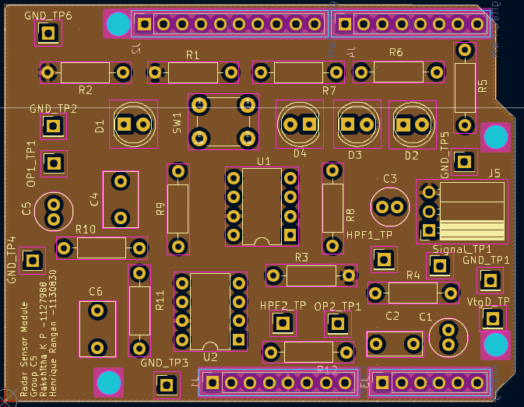
PCB LAYERS
Description: PCB Back Layer for DATA
Description: PCB front Layer for DATA
Description: PCB GND Layer
Description: PCB PWR Layer

Slide 6
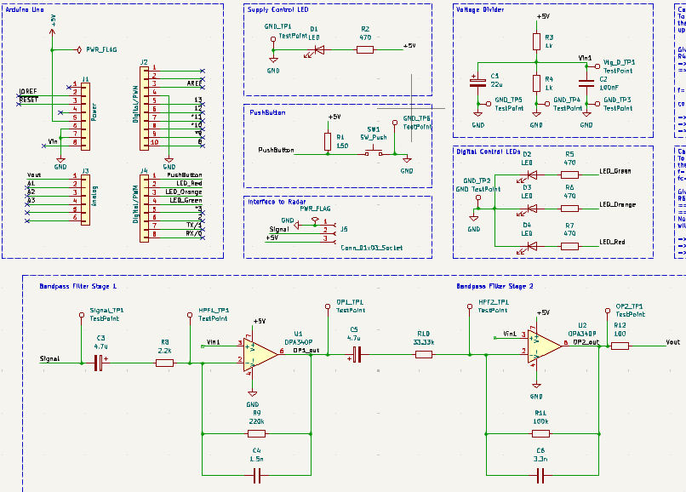
PCB SCHEMATIC
Description: Circuits implemented in PCB in KiCAD

Slide 7
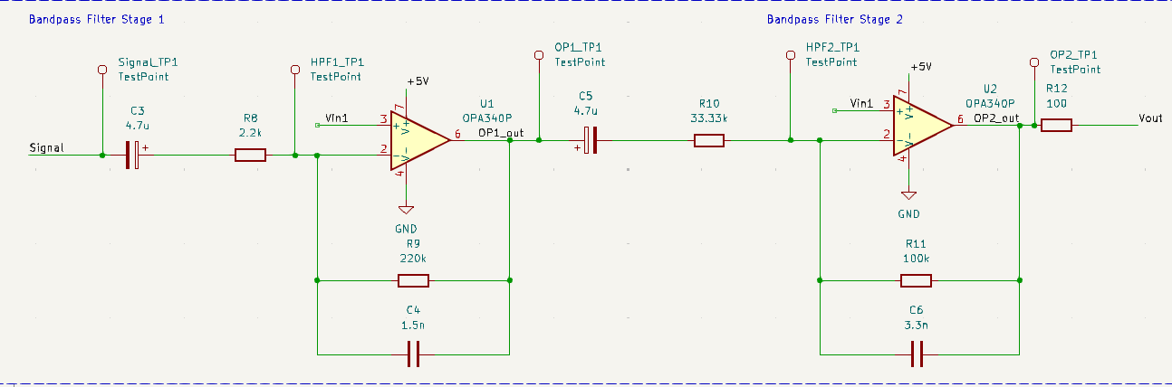
AMPLIFIER CIRCUIT
1st STAGE:
Av = 100
fl = 15.392 Hz
fh = 482.287 Hz
fc = 86.15 Hz
2nd STAGE:
Av = 3
fl = 1.0261 Hz
fh = 482.287 Hz
fc = 22.245 Hz
Description: Amplifier Circuit in KiCAD

Slide 8
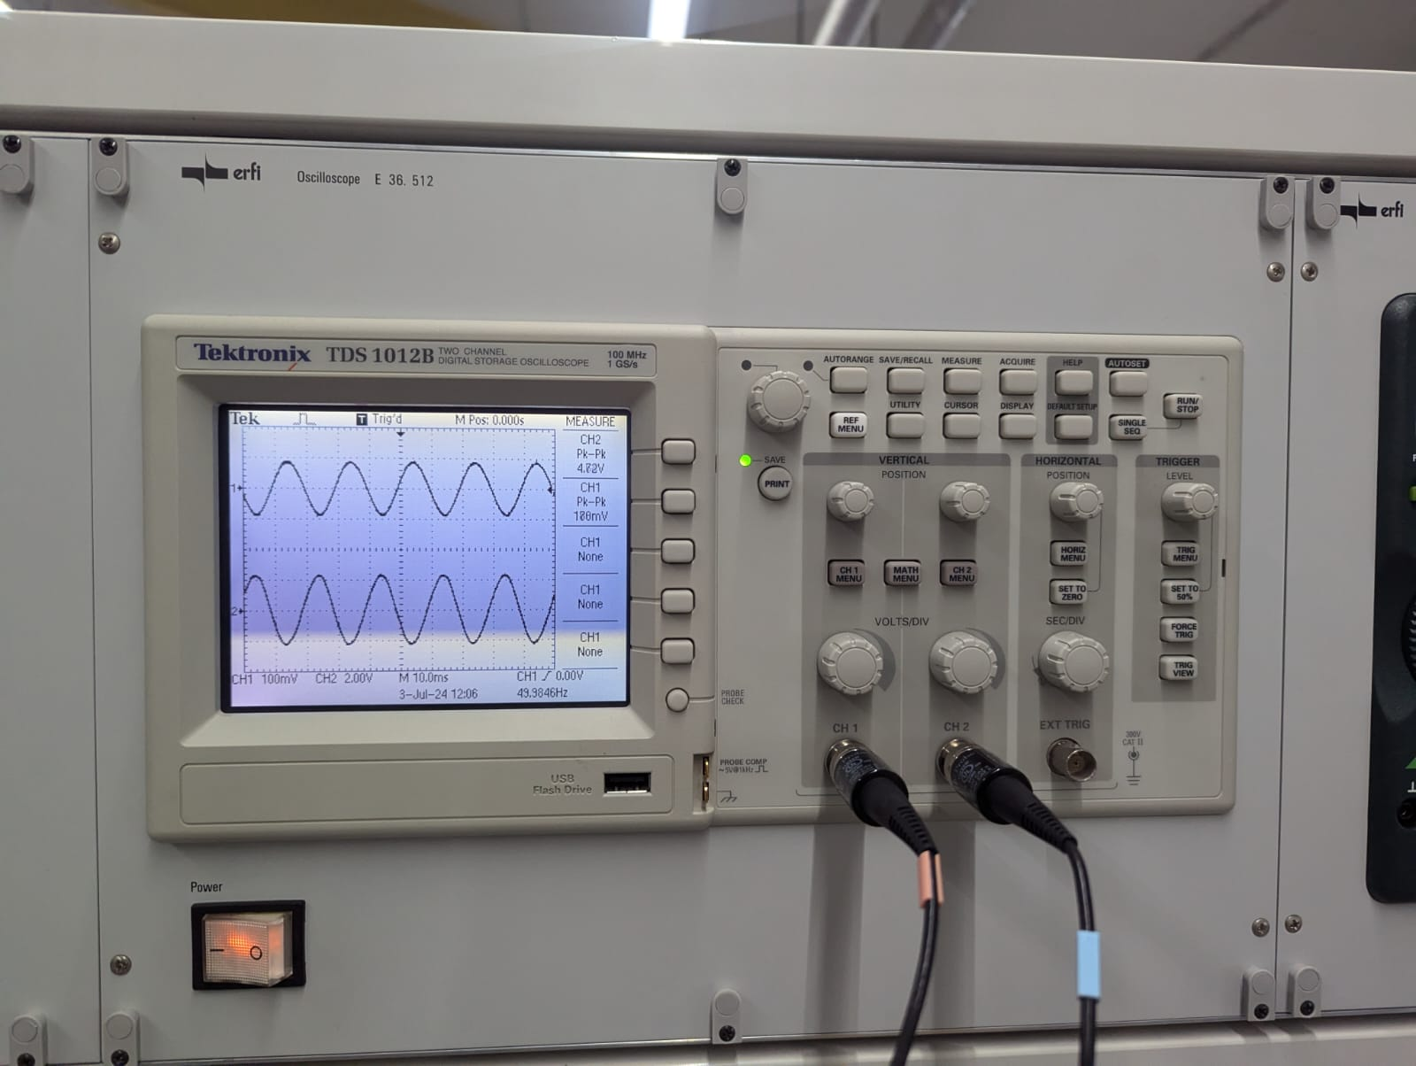
Output of Stage 1:
To determine the corner frequencies of the first stage, we use the formula to calculate upper and lower cut-off frequency,
Given: Voltage Gain Av = 100
R4 = 220kOhm
=> R1 = R4/ Av
=> R1 = 2.2k Ohm
f=1/2*pi*R*C
corner frequency: fc= sqrt(fl*fh)
=> fl = 15.392 Hz
=> fh = 482.287 Hz
=> fc = 86.15 Hz

Slide 9
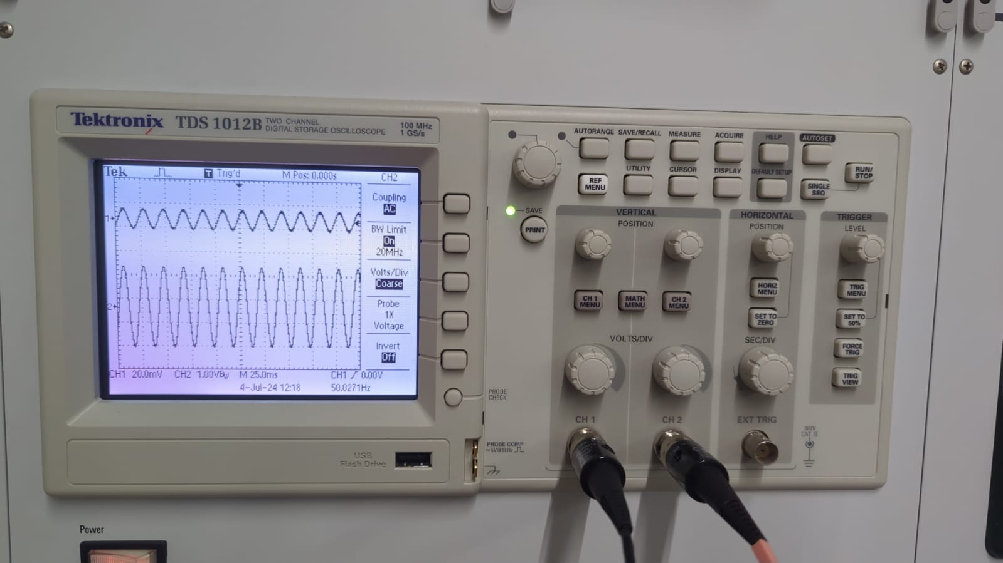
Output of Stage 2:
To determine the corner frequencies of the stage 2, we use the formula f=1/2*pi*R*C and fc= sqrt(fl*fh)
Given: Voltage Gain Av = 3
R6 = 100kOhm
=> R5 = R6/ Av
=> R5 = 33.33kOhm
Note: Since 33.33k is not a standard E24 series resistor, we will be using a 33kOhm Resistor
fc= sqrt(fl*fh)
=> fl = 1.0261 Hz
=> fh = 482.287 Hz
=> fc = 22.245 Hz

Slide 10
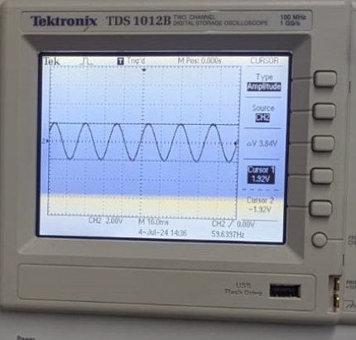
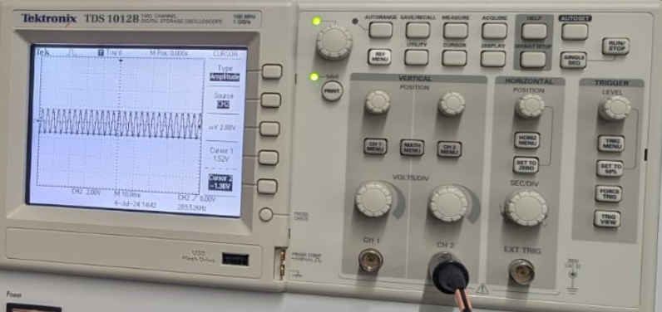
Measured cutoff
fc1 = 17Hz
fc2 = 362Hz

Slide 11
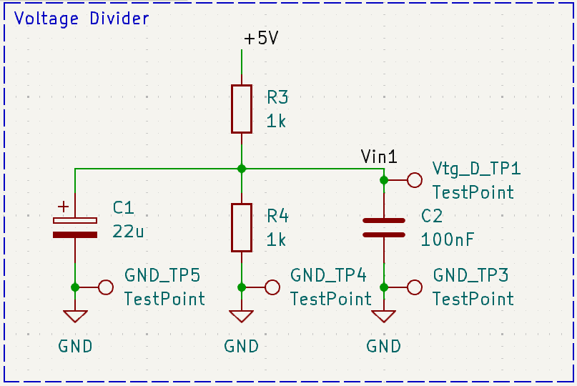
VOLTAGE DIVIDER
VOLTAGE DIVIDER:
Divided by 2;
Capacitor: to stabilize the signal input and filter Noise;
Vin Test Point;
Gnd Test Point.
Description: Voltage Divider implemented in PCB in KiCAD

Slide 12
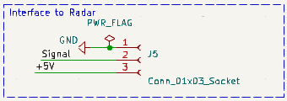
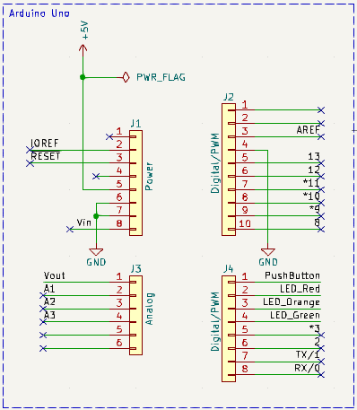
PSoC AND RADAR INTERFACE
Description: Radar Interface implemented in PCB in KiCAD
Radar Interface:
3 Pins for Vcc, Signal input and Gnd;
Arduino Pins:
To connect the PCB on the PSoC;
Description: Arduino Pins implemented in PCB in KiCAD

Slide 13
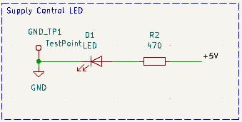
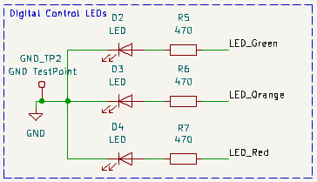
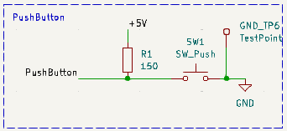
LEDS AND BUTTON
Description: Power Supply LED implemented in PCB in KiCAD
Description: LEDs implemented in PCB in KiCAD
Used for debugging (identifying current state of statemachine) and identify if a target is detected
Description: Push-Button implemented in PCB in KiCAD

Slide 14
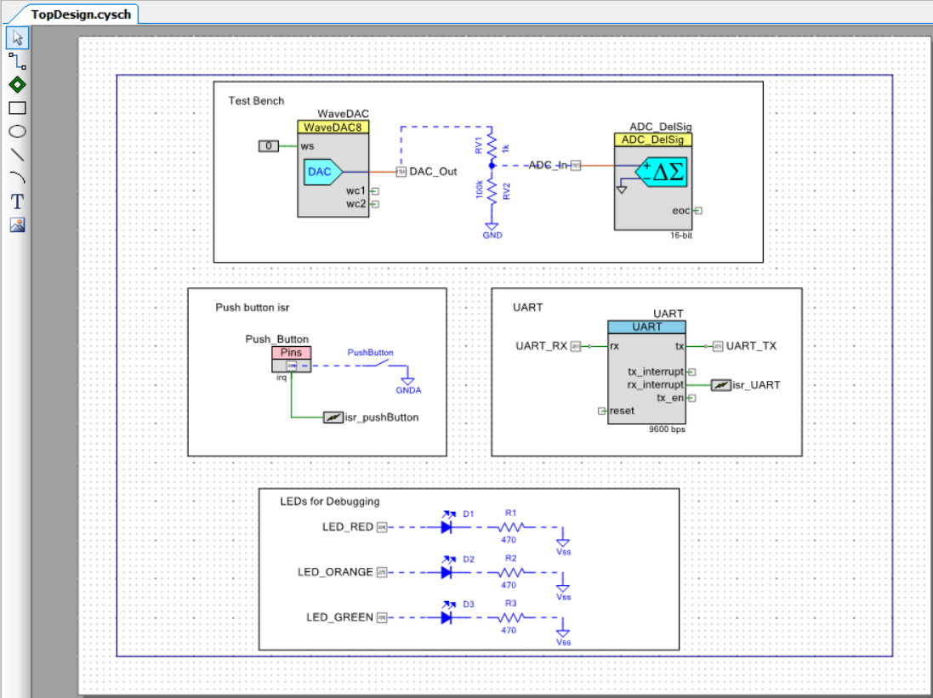
Software Development on PSoC Statemachine implementation
Objective:
To test the performance of an amplifier using the FreeSoC 2 platform and a MATLAB script for data acquisition and control.
The task is to use a DAC, which provides the test signal. Use a 16-bit SD-ADC to sample the voltage divider output and store the samples in an array. If Matlab requests by UART, send the ADC sampled data by UART to Matlab. This is repeated 10 times before the Matlab Script terminates.

Slide 15
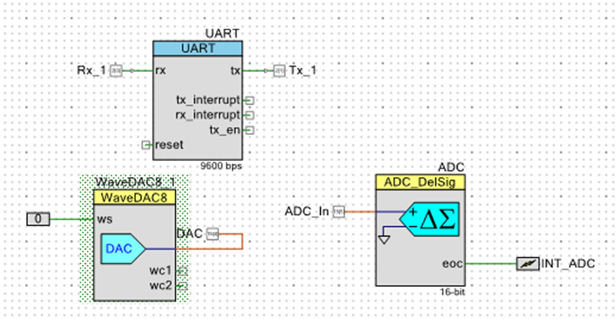
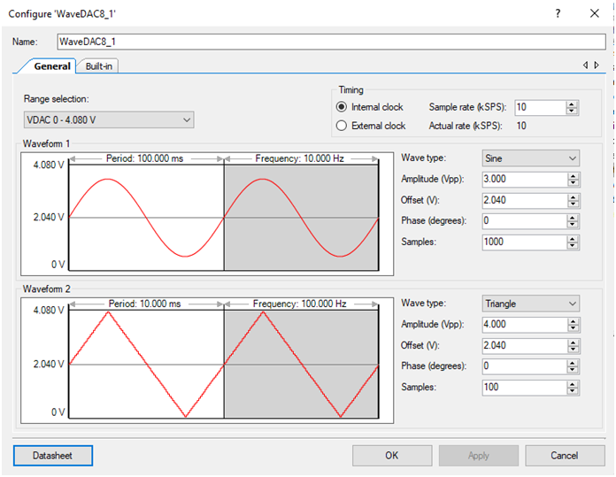
Software Component
Waveform DAC
Automatic periodic waveform generation, here sine wave of 3V peak-peak
Input signal of the test bench
DAC updates the output value 10,000 times per second (Sample rate – 10kSPS)

Slide 16
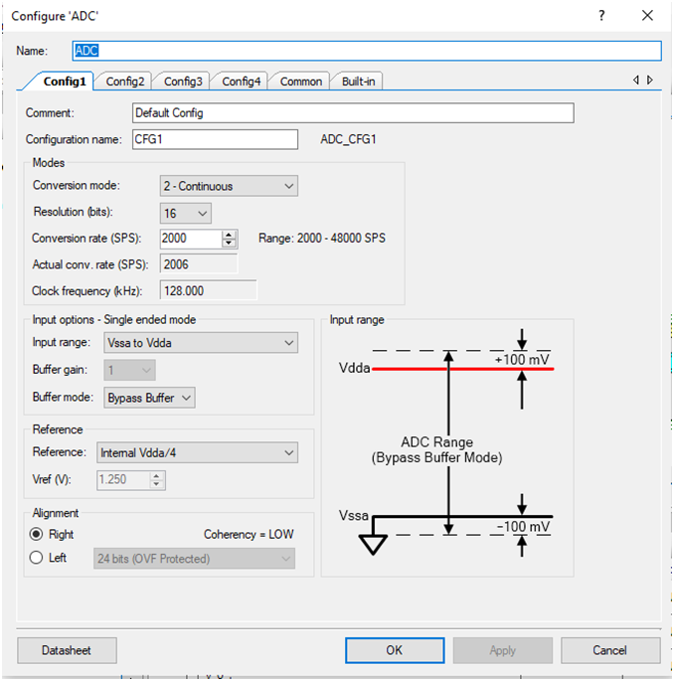
Delta Sigma Analog to Digital Converter
It provides a low-power, low-noise front end for precision measurement applications;
In Input Range as Vssa to Vdda an external reference is not used;
Continuous Sample mode to measure a single input signal

Slide 17
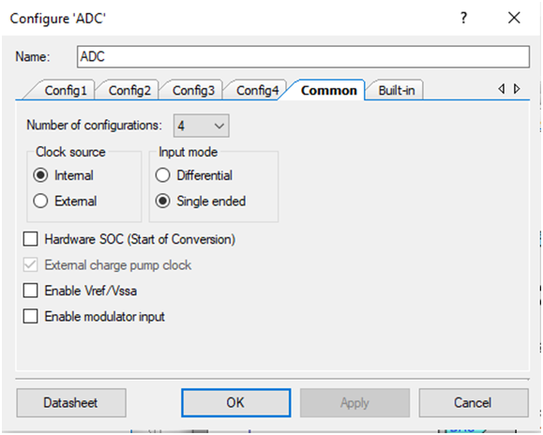
Delta Sigma Analog to Digital Converter
ADC is inherently differential
Single-ended mode is implemented by internally connecting the negative input to ground.

Slide 18
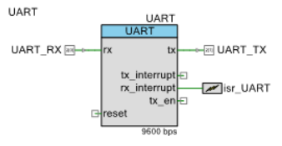
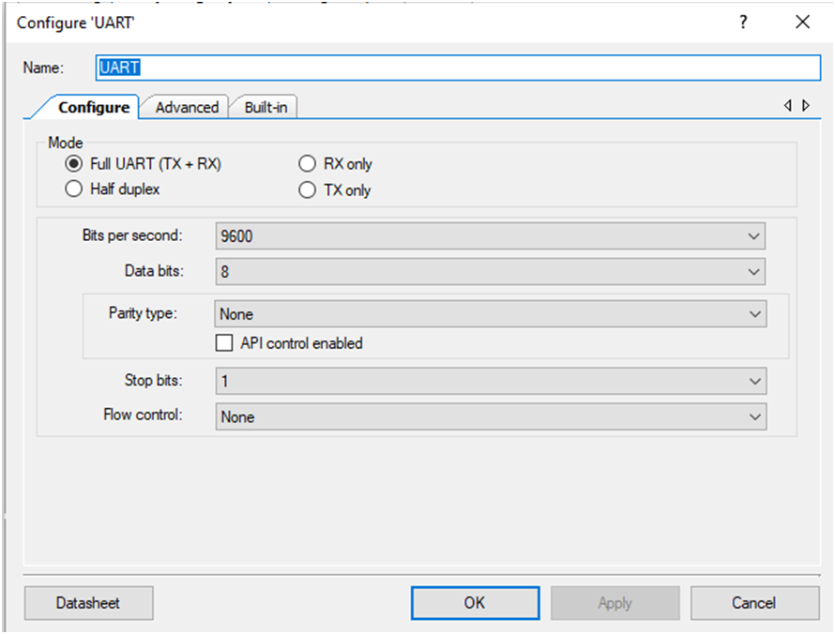
Universal Asynchronous Receiver Transmitter (UART)
The UART provides asynchronous communications commonly referred to as RS232 or RS485;
The UART Component can be configured for Full Duplex, Half Duplex, RX only, or TX only versions;
The main reason for this to be used was to transmit the adc data to MATLAB and receive ‘s’ character.

Slide 19
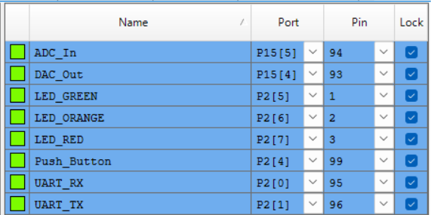
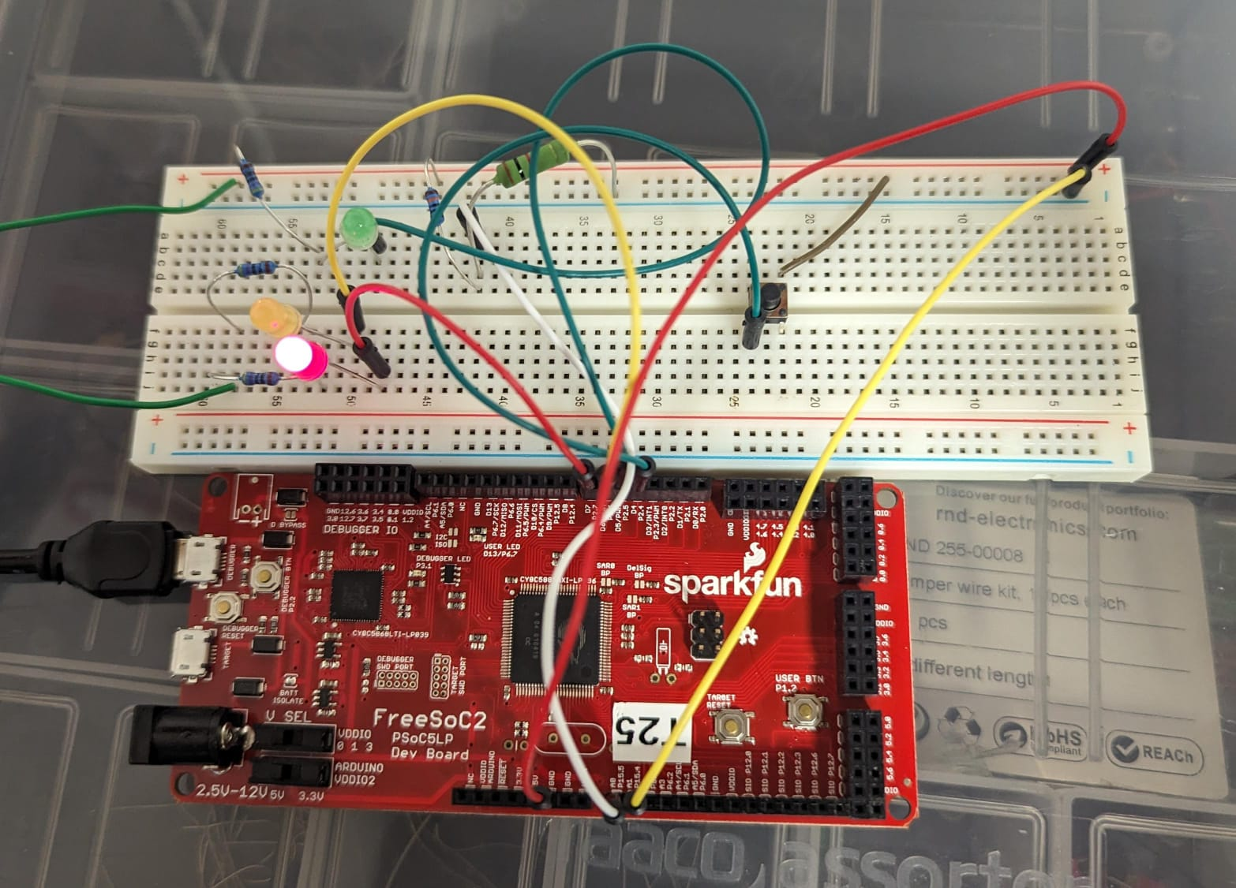
PINS CONFIGURATIONS AND SETUP

Slide 20
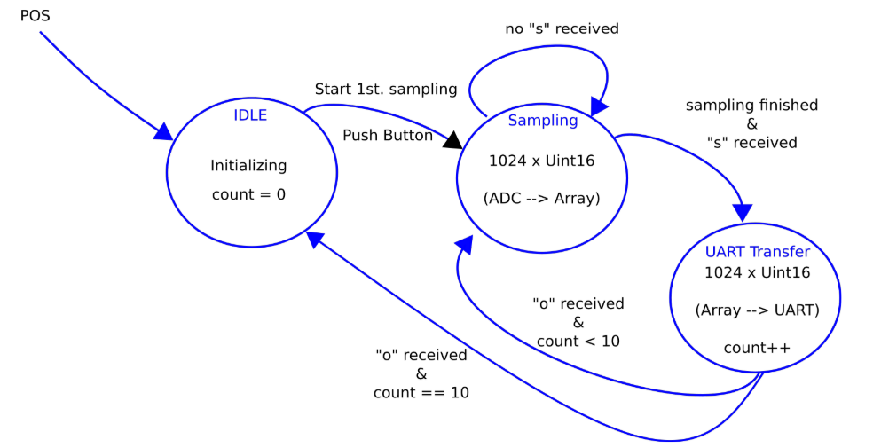
Statemachine – implemented using switch case

Slide 21
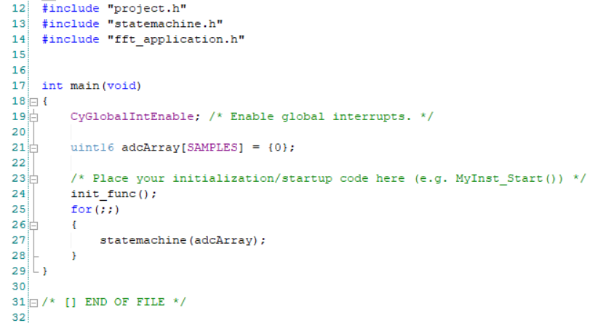
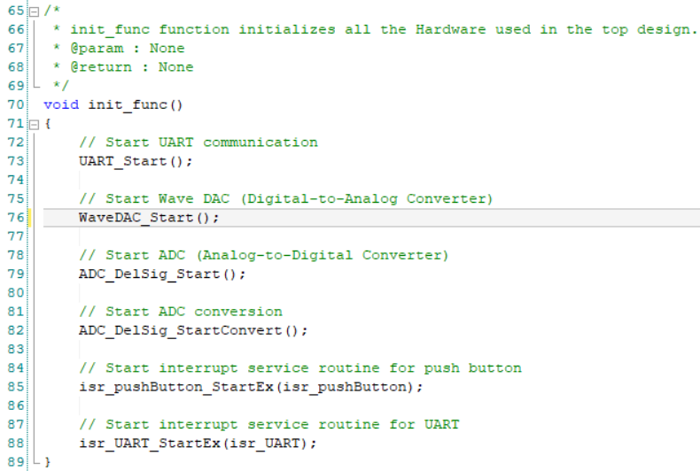
Software Development on PSoC
An array for storing ADC data is declared and initialized to 0.
SAMPLES is a macro defined to be the size of the data i.e 1024
An initialize function is called before starting the statemachine, which initializes all the software components used, for example, the UART, DAC, ADC, ISRs
2 ISRs are used: An interrupt is generated at the falling edge of the button press and another when the UART receives any data.

Slide 22
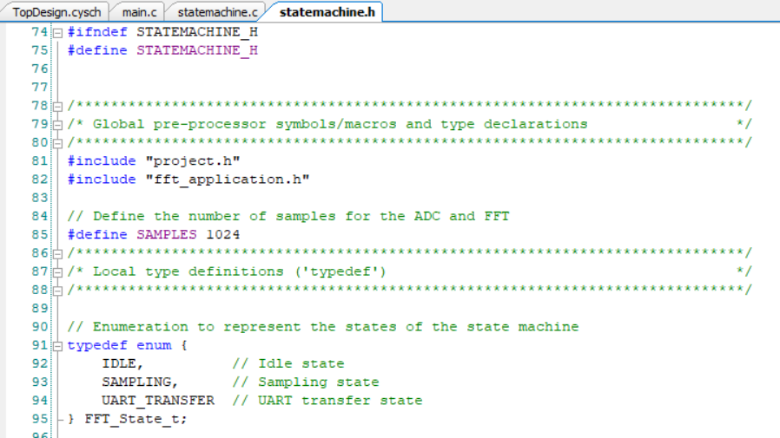
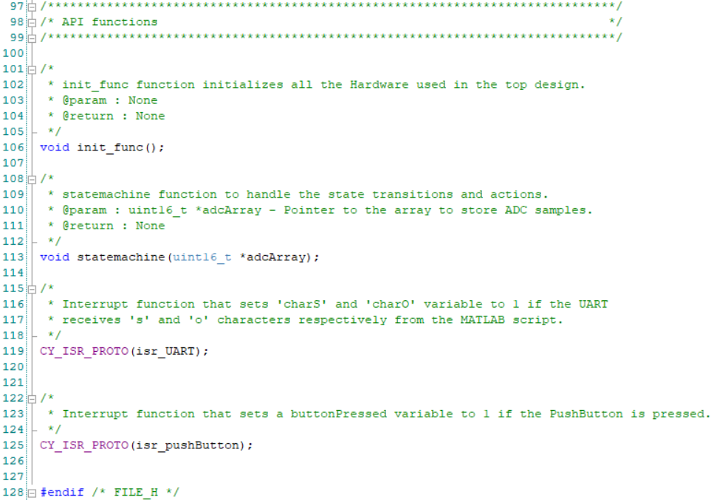
Statemachine header
An enum for the different states of the statemachine is defined.
3 states idle, sampling and UART_transfer are used in the switch-case statemachine implementation
The function definitions are also defined in the header:
Init_func() as mentioned in previous slide initializes all the software components
The statemachine function takes a pointer to the array that stores ADC samples as a parameter
An ISR function prototype is used to declare the ISR. An interrupt is raised when the character ‚s‘ is received by the UART.
Interrupt function CY_ISR_PROTO sets a buttonPressed variable to 1 if the PushButton is pressed.

Slide 23
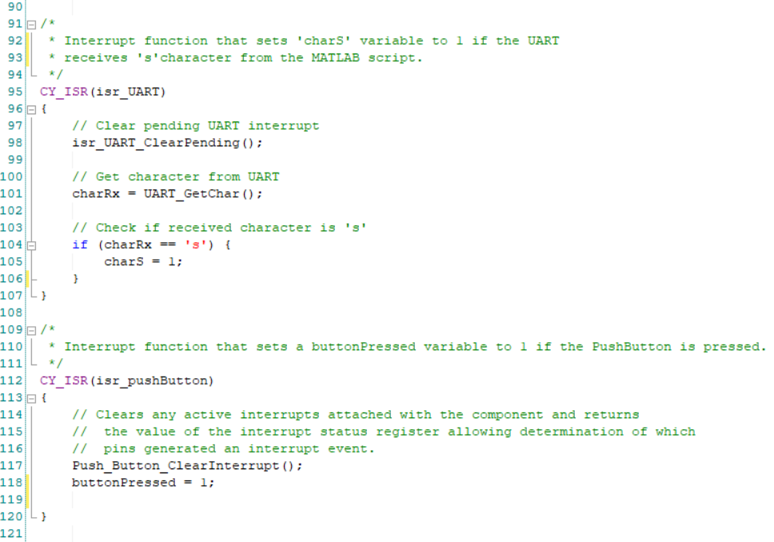
ISR
Isr_UART is an ISR function that sets a variable to 1 if a character ‚s‘ is received from the MATLAB script by the UART.
Isr_pushButton is an ISR function that sets the varibale ButtonPressed to 1 when the push button is pressed. At the falling edge of the push button, an isr is generated.

Slide 24
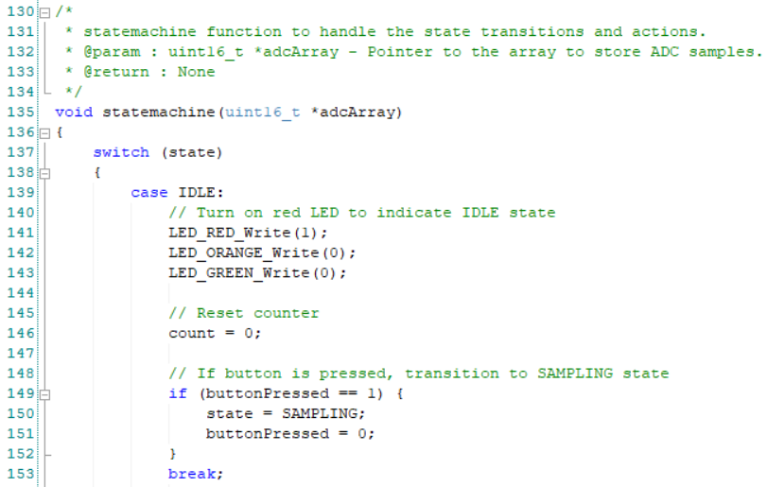
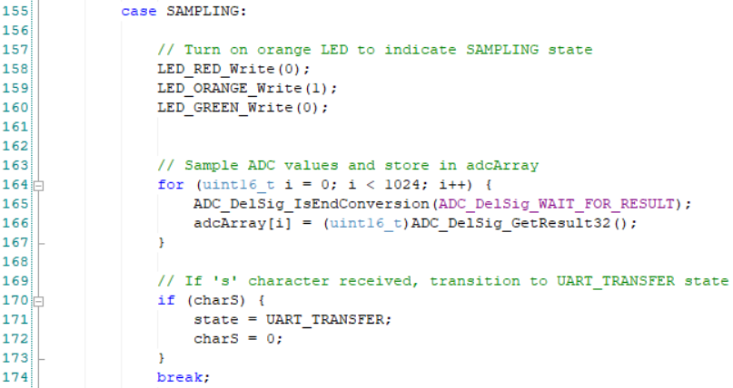
Statemachine code
The LEDs are used to indicate the current state of the system.
Idle state
The Red LED is used to indicate that the system is in the idle state.
a counter is initialized to 0
If a button is pressed, a state transition is initiated.
The state is modified to SAMPLING and the buttonPressed variable is set back to 0.
Sampling state
The Orange LED is used to indicate that the system is in the SAMPLING state
The ADC_DelSig_IsEndConversion function checks the status that the most recently started conversion has completed
ADC_DelSig_WAIT_FOR_RESULT - Does not return until ADC conversion is complete.
ADC_DelSig_GetResult32 returns the result of the last ADC conversion, which is stored in an array
If a character ‘s’ is received, a state transition is initiated

Slide 25
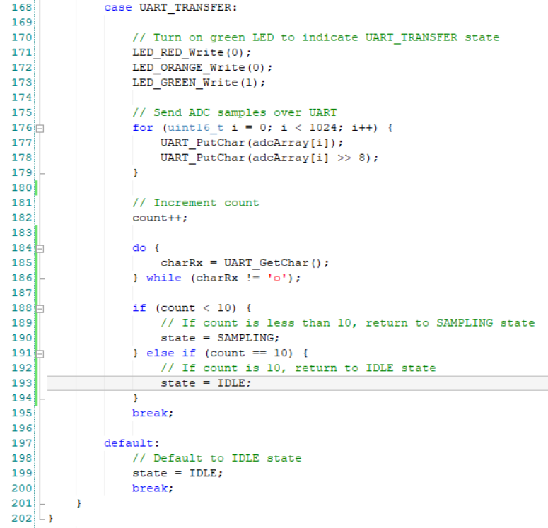
Statemachine code
UART_TRANSFER state
The Green LED is used to indicate that the system is in the UART_TRANSFER state
The system sends ADC samples over UART.
It iterates over the ‘adcArray’ containing 1024 samples.
For each sample, it sends the lower and upper 8 bits over UART using the UART_PutChar function.
The ‚count‘ variable is incremented to keep track of the number of data transfers.
The system waits for the reception of the 'o' character through UART.
The ‘do-while’ loop is used to continuously call ‘UART_GetChar’ until the 'o' character is received.
If the count is less than 10, a state transition is initiated.
The state is modified to SAMPLING.
If the count equals 10, a state transition is initiated.
Default state
The system defaults to the IDLE state if an undefined state value is encountered.

Slide 26
FFT
1.Transform to Frequency Domain:
The FFT converts a signal from its original time domain into the frequency domain. This process decomposes the signal into its constituent frequencies.
2. Identify Noise Components:
In the frequency domain, noise and the desired signal components can often be distinguished. Noise is usually spread across a wide range of frequencies, while the desired signal might occupy a specific frequency range.
3. Apply a Filter:
Once the noise frequencies are identified, a filter can be applied to remove or reduce these unwanted components. Common filters used in this context include low-pass, high-pass, band-pass, and band-stop filters.
4. Inverse FFT:
After filtering the unwanted frequencies, the inverse FFT (IFFT) is applied to convert the signal back to the time domain. The result is a signal with reduced noise.

Slide 27
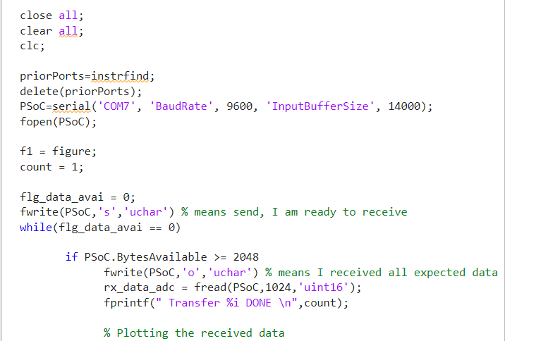
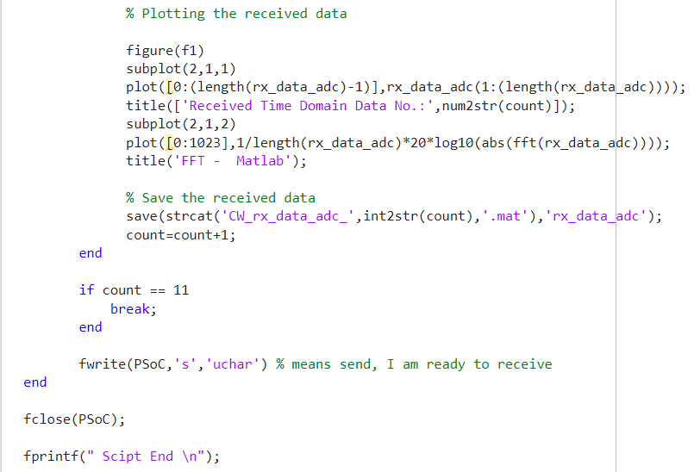
MATLAB script for receiving ADC data from PSoC and plotting it on a graph

Slide 28
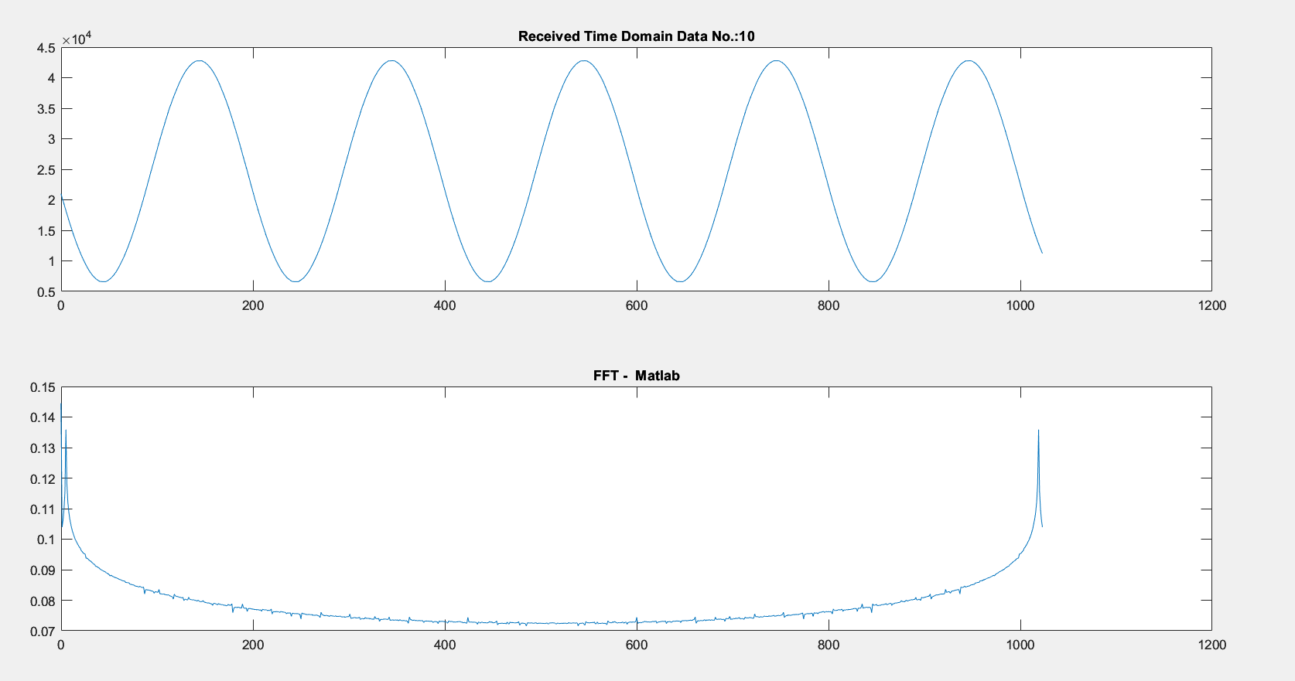
OUTPUT of FFT on MATLAB

Slide 29
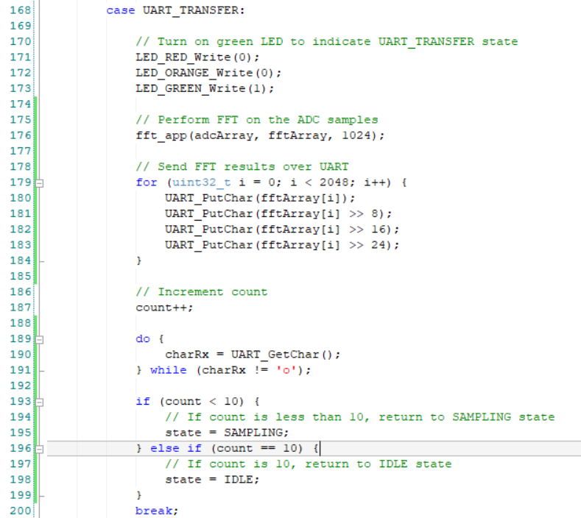
Statemachine code for FFT implementation on PSoC
The code for the IDLE and SAMPLING states remain the same
UART_TRANSFER state
The Green LED is used to indicate that the system is in the UART_TRANSFER state.
The Fast Fourier Transform is performed on the ADC samples that are present in the ‘adcArray’
It processes the adcArray which contains 1024 samples.
The FFT results are sent over UART. For each element in fftArray:
UART_PutChar(fftArray[i]) sends the least significant byte.
UART_PutChar(fftArray[i] >> 8) sends the second byte.
UART_PutChar(fftArray[i] >> 16) sends the third byte.
UART_PutChar(fftArray[i] >> 24) sends the most significant byte. This sends a total of 2048 bytes (4 bytes per element in fftArray)
The ‘do-while’ loop is used to continuously call ‘UART_GetChar’ until the 'o' character is received.
If the count is less than 10, a state transition is initiated to SAMPLING state.
If the count equals 10, a state transition is initiated.

Slide 30
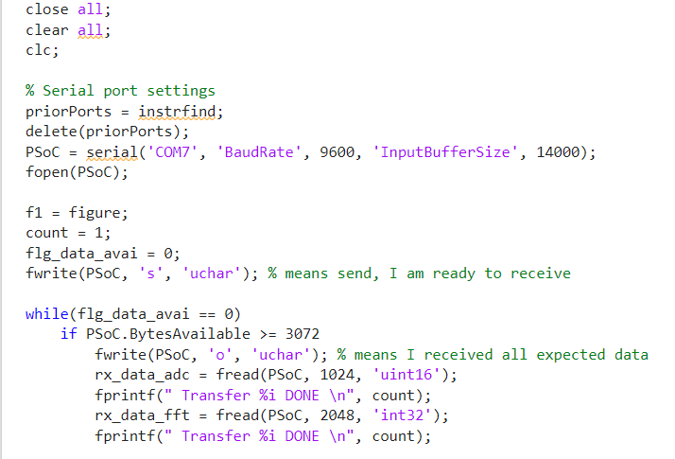
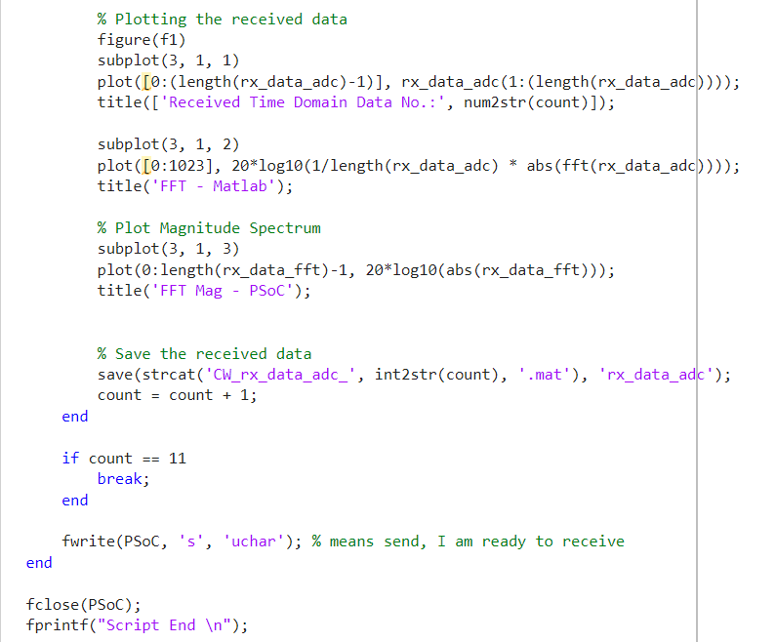
MATLAB script for receiving ADC and FFT data from PSoC and plotting it on a graph

Slide 31
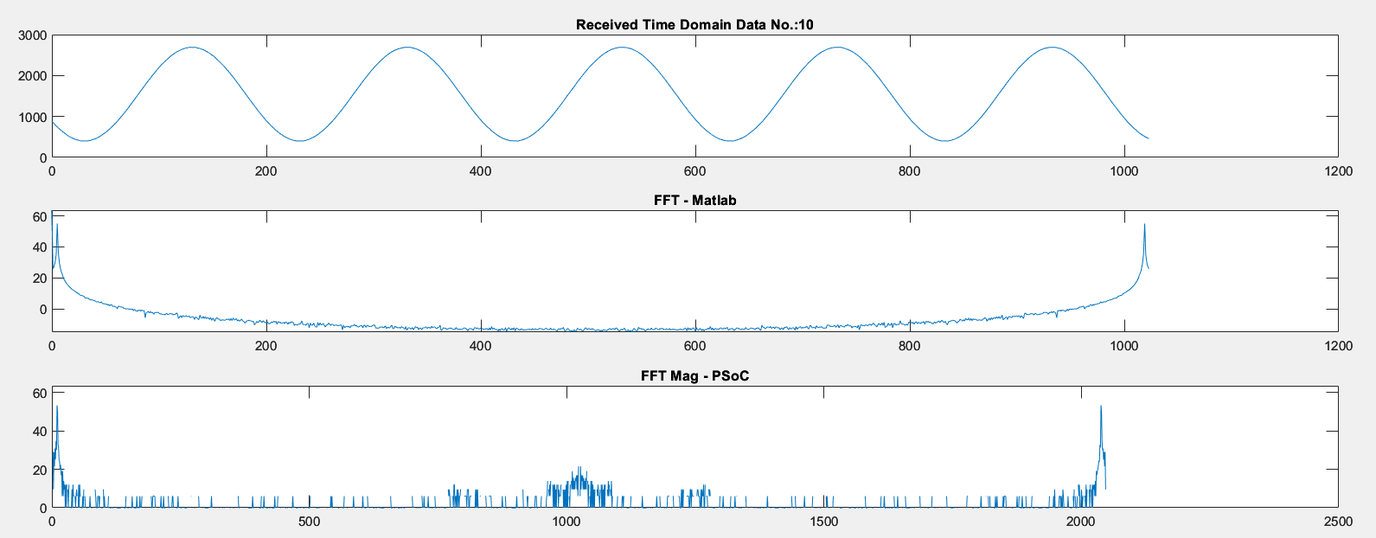
OUTPUT of FFT from PSoC

Slide 32
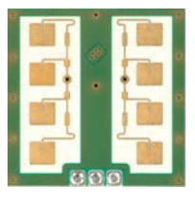
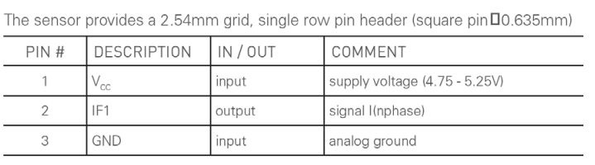
IPM 165 - 24 GHz CW Radar
The IPM-165 is a 24GHz Doppler module with an asymmetrical wide beam for detection of moving objects
CFAR
CFAR (Constant False Alarm Rate) is a signal processing technique commonly used in radar systems and other detection systems to automatically adjust the detection threshold, ensuring a consistent rate of false alarms despite varying levels of background noise or clutter. The main goal of CFAR is to maintain a constant probability of false alarms, which is crucial for reliable detection of targets.

Slide 33
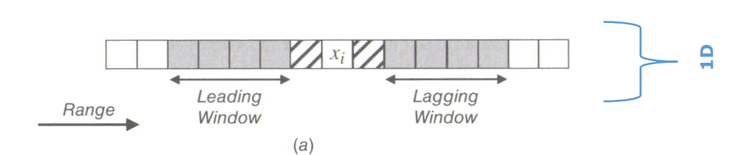
CA-CFAR
Adaptive Threshold Setting:
The detection threshold is adaptively set as a function of the estimated noise level. For instance, in CA-CFAR, the threshold TTT is typically set as:
T=α⋅Noise Estimate
Where α is a scaling factor determined by the desired false alarm rate.
Cell under test (CUT) is xi • Noise in the CUT determines the threshold • The noise parameters in the CUT has to be estimated (here: σw^2)

Slide 34
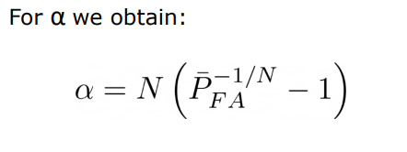
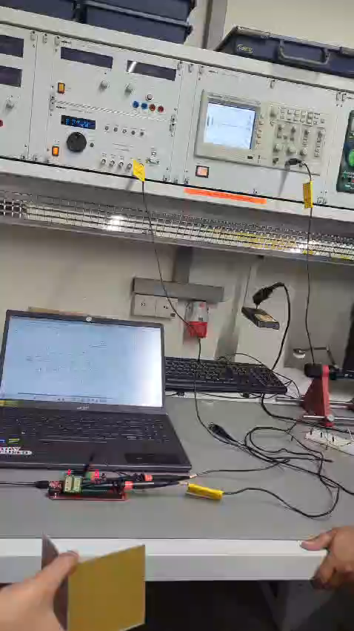
CA-CFAR
With:
N : number of averaged cells
PFA : target false alarm probability
The video shows the output of the 2nd stage
of the amplifier, with the radar module
connected.

Slide 35
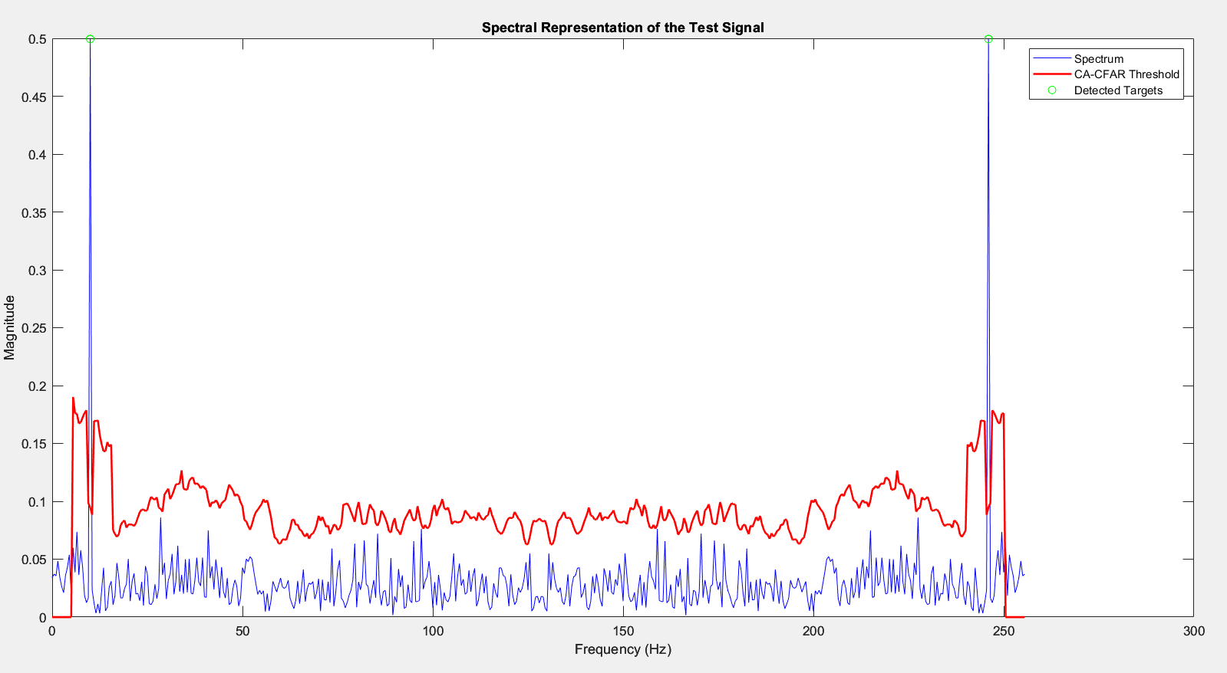
Spectral Representation of a Test signal generated in MATLAB
The Green dots on the spectrum indicates the detected targets

Slide 36


Matlab code for pre-recorded RADAR data

Slide 37


Sample set 1
Sample set 2

Slide 38

MATLAB CA-CFAR implementation

Slide 39

CA-CFAR included in the statemachine
LED red glows when target is detected

Slide 40
THANK YOU

Slide 41


Software Development on PSoC
Exercise 1: UART Talkback
Develop a software on the PSoC, which receives the data from a terminal program on the windows and writes it back to the terminal in capital letters.
Step1: Write Back the text
Step2: Capitalize it

Slide 42


Software Development on PSoC
The UART receives characters from the terminal and transfers the character back to the terminal

Slide 43


Software Development on PSoC
Method 1 and 2 mentioned above produce the same result of capitalizing the text and writing back onto the terminal.
Method 1 checks if every character that is received through the UART is a lowercase aphabet and it subtracts 32 from the character to generates its corresponding Upper case in ascii
Method 2 checks if the received character is not null and uses “toupper” function which converts the lowercase alphabet to upper case and displays on the terminal

Slide 44




Wave Generation in PSoC
Expected Behaviour:
1. sends 's' over the serial Port
2. Waits until there are 256 bytes in the buffer
3. If there 256 bytes in the buffer, it take them, calculates the fft out of it and displays the received data and the absolute of the fft.

Slide 45




Wave Generation in PSoC
TRIANGLE WAVE GENERATION
SQUARE WAVE GENERATION

Slide 46




Wave Generation in PSoC
SAWTOOTH WAVE GENERATION
STEP WAVE GENERATION

